Slide 1

-
control
™
An all-natural appetite-suppressing weight loss product*
*These statements have not been evaluated by the FDA. This product is not intended to diagnose, treat, cure, or prevent any disease
Notes:
Today, we have exciting news about a new product joining our Slim & Sassy weight management line. This proprietary product is called CONTROL, and its main benefit—you guessed it—is appetite control.

Slide 2
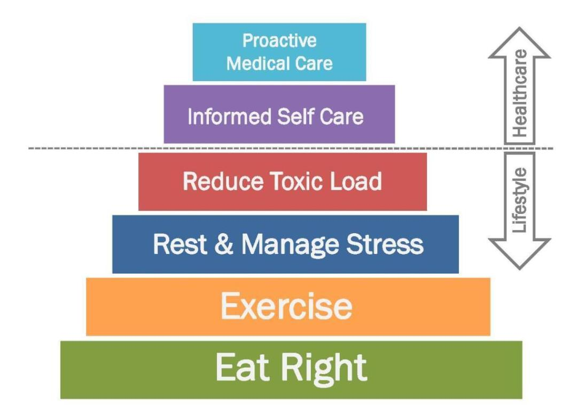
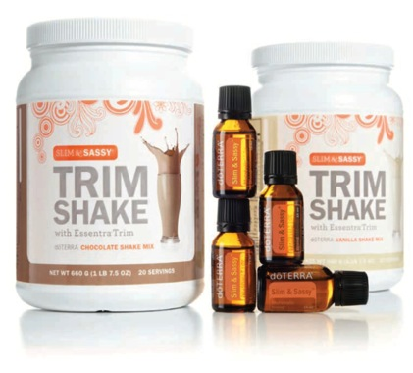
dōTERRA Wellness Lifestyle
®
Notes:
If you struggle with weight like many, you’ve probably figured out what scientists and doctors already know: that there is no magic weight loss pill. We just can’t keep eating too much and exercising too little and then expect a pill to fix it.
Successful weight loss requires lifestyle improvements. Weight management is right at the foundation of our doTERRA Wellness Lifestyle, and if you like it or not, it involves eating right and exercising. These lifestyle improvements need to be long-term changes to really get lasting results.
Our current Slim & Sassy program already provides excellent products and tools to help people reach their goals, including the Slim & Sassy Metabolic essential oil blend and our high-protein Trim Shakes.
However, for most of us, the greatest challenges are the cravings and snacking that sneak up on us in between meals or after dinner. Wouldn’t it be nice to have a product that can help us gain more appetite control?

Slide 3

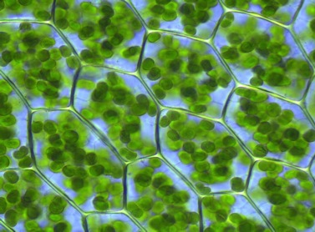
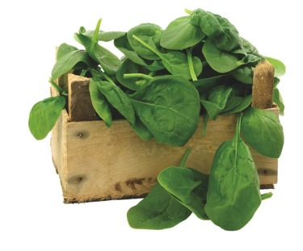
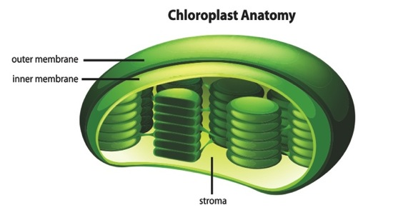
-
Control
™
Appethyl™ Spinach Extract
Discovered at Lund University, Sweden; 8 years of research
Exclusive to dōTERRA (worldwide direct sales channel)
Slows down fat digestion → appetite control*
Thylakoid
Spinach Cells
With Chloroplasts
Appethyl® is a trademark of Greenleaf Medical AB
*These statements have not been evaluated by the FDA. This product is not intended to diagnose, treat, cure, or prevent any disease
Notes:
Recently, a new product joined our Slim & Sassy weight management line. This proprietary product is called CONTROL, and its main benefit—you guessed it—is appetite control. This breakthrough product controls cravings by helping the body feel full.
Control features a revolutionary extract made from spinach called Appethyl. This extract has been developed at the prestigious Lund University in Sweden and it took 8 years of research. And, the best news is that doTERRA has acquired the exclusive rights to Appethyl for our sales channels worldwide!
The extract is very unique, because [click animation] it uses only the green chloroplasts within the spinach cells, and [click animation] in these chloroplasts there are membrane structures called “thylakoids” that look like stacks of coins. These thylakoids is what we’re after, because they can bind dietary fats.
Appethyl works so well, many people feel reduced appetite and cravings after the first try! In fact, there are 8 human clinical studies showing that it reduces appetite and cravings, and that it helps people lose weight when used as part of a weight-management program.

Slide 4
Eight Clinical Studies
Hunger Ratings
Placebo
Breakfast
0 15 30 45 60 90 120 180 240
Time after Breakfast (minutes)
*These statements have not been evaluated by the FDA. This product is not intended to diagnose, treat, cure, or prevent any disease
Notes:
Here are the results of one of these clinical studies. You can see the hunger ratings in the blue bars before and after breakfast and 4 hours thereafter. As you would expect, people are very hungry before breakfast, shown on the left-most bar. The breakfast suppresses hunger for about 2 hours (120 min), and at 3 and 4 hours you can see hunger ratings go up again as lunch time approaches.
Now, let’s see what happens when the same people ate the same breakfast except this time with the Appethyl spinach extract…

Slide 5
Eight Clinical Studies
Appethyl® suppresses appetite by 50% after 3-4 hours*
Hunger Ratings
Placebo
Appethyl®
Breakfast
0 15 30 45 60 90 120 180 240
Time after Breakfast (minutes)
*These statements have not been evaluated by the FDA. This product is not intended to diagnose, treat, cure, or prevent any disease
Notes:
The Appethyl data is shown in the green bars. And you can see how Appethyl reduced hunger ratings by over 50% 3 to 4 hours after breakfast. That’s right before lunch, or when it matters the most. This is a very noticeable reduction in hunger ratings, and this has been reproduced in several other studies.
So, how does Appethyl work? Essentially, it works by helping our digestive system signal to the brain that we are full. Let’s explain…

Slide 6
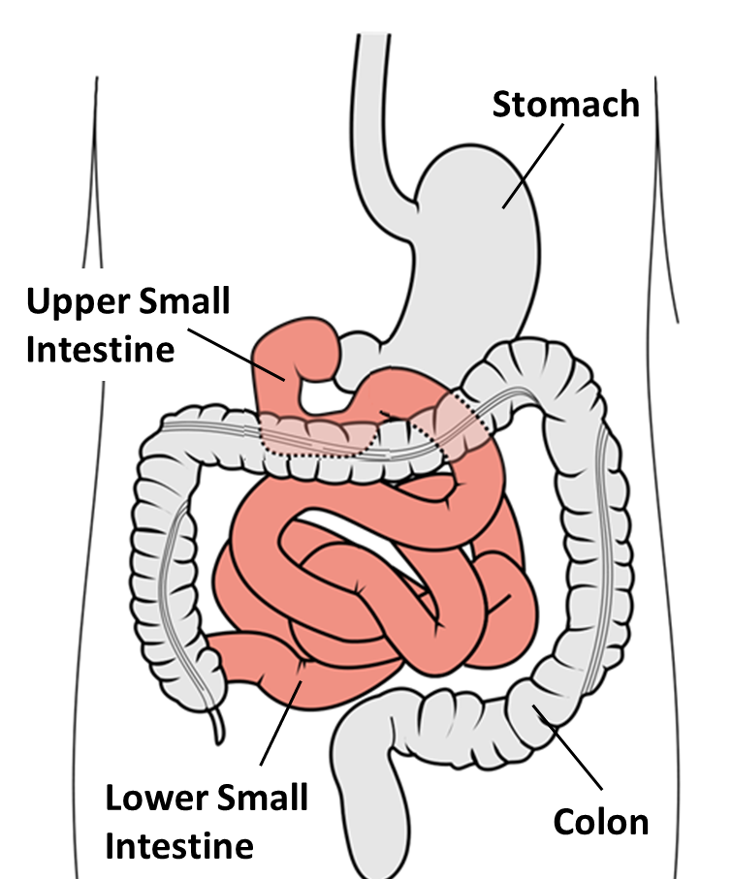
Ancient Diets
Fat
Digestion
Notes:
Nature created our digestive system to deal with rough and completely unrefined diets, and in ancient times it used to take the entire 23 feet of small intestine to get the fats digested and absorbed. That’s shown here in the dark pink color. So some fat made it all the way to the lower end of the small intestine.

Slide 7
Ancient Diets
Notes:
In the wall of the lower intestine we have special receptors that detect undigested fat. And as soon as there is fat in the lower intestine …

Slide 8

Ancient Diets
“Don’t eat!
I’m full!”
CCK
Notes:
… these receptors send a powerful message (CCK, cholecystokinin) to the brain saying: “Don’t eat! I’m full!” That’s how we all should control our food intake naturally.

Slide 9
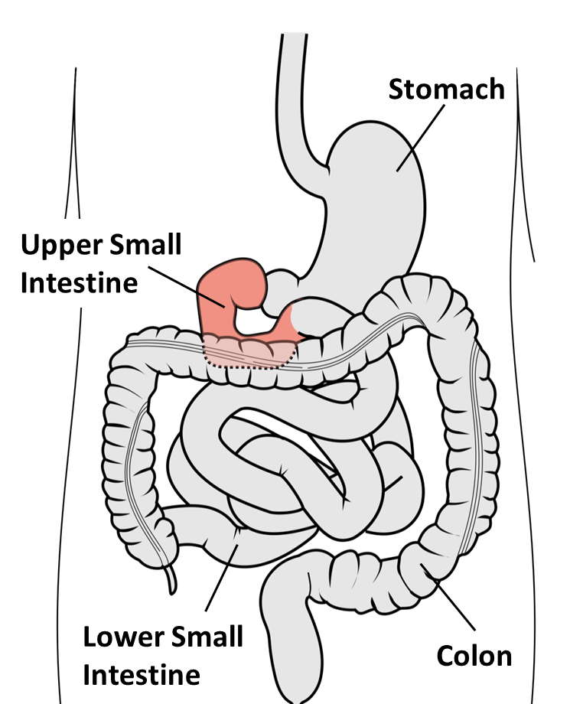
Today’s Diets
Notes:
Today, however, we eat refined foods that are easier and faster to digest than our ancient diets. So the fats in today’s diets are digested and taken up quickly in the upper intestine and they hardly ever make it down into the lower intestine. Plus, people who diet often eat fat-free foods.

Slide 10

Today’s Diets
“Keep
eating!”
?
Notes:
And because of that, these fat receptors in the lower intestine are not turned on, and so they cannot tell the brain to stop eating. That’s why it’s so easy to overeat these days. There is nothing wrong with our digestive system, but it doesn't work well with the modern 'pre-chewed' refined foods.

Slide 11
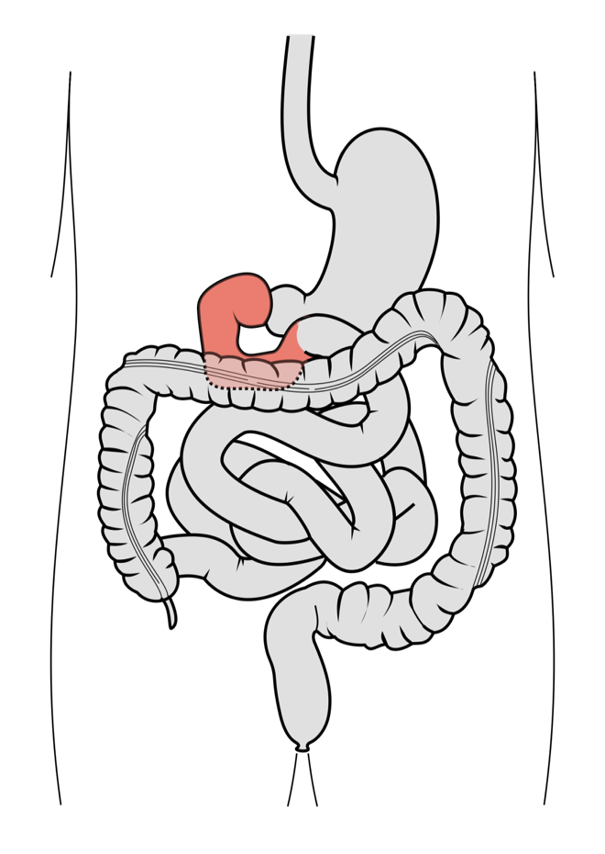
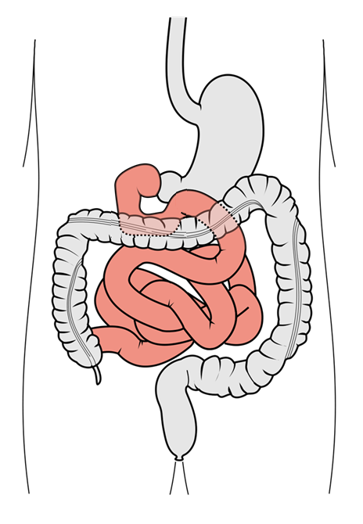
Today’s Diets…
…without
contrōl
…with
contrōl
Upper Small
Intestine
Upper Small
Intestine
Lower Small
Intestine
Lower Small
Intestine
*These statements have not been evaluated by the FDA. This product is not intended to diagnose, treat, cure, or prevent any disease
Notes:
Now this is where our Slim & Sassy Control comes in. On the left side you see fat digestion without Control and on the right with Control. As you can see, Control slows down fat uptake from modern diets so that it shows up in the lower intestine like it used to in ancient times.

Slide 12
Today’s diets with contrōl
“Don’t eat!
I’m full!”
CCK
*These statements have not been evaluated by the FDA. This product is not intended to diagnose, treat, cure, or prevent any disease
Notes:
And now our natural way of controlling appetite is working again: The receptors in the lower intestine see some undigested fat and they tell the brain: “Don’t eat, I’m full.” Slim & Sassy Control slows down fat digestion and uptake; it’s giving our intestinal messengers time to be released and communicate to the brain that we are satisfied.

Slide 13
Restores the natural way to control appetite*
☺
Sustained, delayed action
-
control
™
*These statements have not been evaluated by the FDA. This product is not intended to diagnose, treat, cure, or prevent any disease
Notes:
So essentially, Control is restoring the natural way to control food intake.
As you can imagine, it takes time for this to happen, and the action lasts for 4 to 6 hours. So, keeping this in mind, here’s how to take Slim & Sassy Control: If you’re like me and your biggest problem is snacking after dinner, then take it with lunch. If you tend to snack throughout the day, then take it with breakfast.

Slide 14
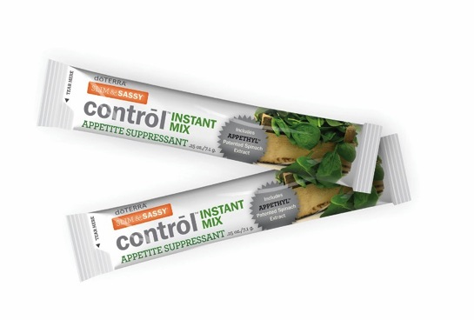
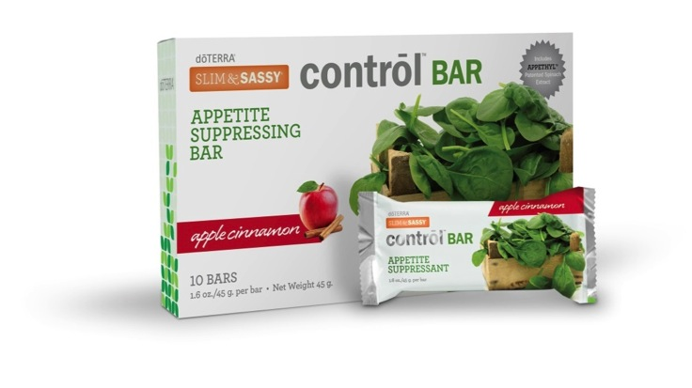
-
Control
™
Available as Instant Mix and Snack Bars
5 grams Appethyl™ (full clinical amount)
Solathin® (supports satiety*)
Slim & Sassy® essential oil blend (Instant Mix only)
Appethyl ® is a trademark of Greenleaf Medical AB
Solathin is a registered trademark of Cyvex Nutrition
*These statements have not been evaluated by the FDA. This product is not intended to diagnose, treat, cure, or prevent any disease
Notes:
Control comes in 2 product forms: an instant mix in a stick pack and snack bars in 3 flavors. All will provide the full clinical amount of Appethyl, which is 5 grams, plus the Solathin extract you know from our Trim Shakes. Solathin also works on appetite reduction.

Slide 15
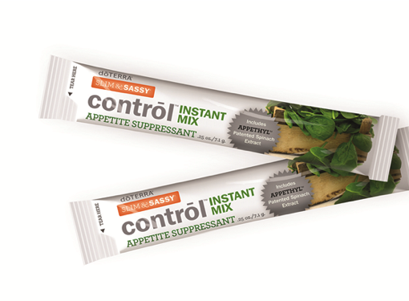
-
Control INSTANT MIX
™
Directions:
Mix 1 stick pack with 4-8 fl. oz. water
With meal, containing some fat (min. 5 g)
  Fat enhances appetite suppression*
    TrimShake with milk, soy milk
    TrimShake smoothie w/avocado
    Fish, xEO Mega /IQmega
    Milk/dairy, vegetable oils
®
®
*These statements have not been evaluated by the FDA. This product is not intended to diagnose, treat, cure, or prevent any disease
Notes:
Our Control Instant Mix is designed to be mixed into 4 to 8 ounces of water. You’ll take it with breakfast or lunch. And make sure these meals contain a little bit of healthy fat. So, for example, you could make a Trim Shake with milk or soy milk, or a Trim Shake smoothie with some avocado. Or a salad with a little olive oil and nuts. The sky is the limit for recipes.

Slide 16

-
Control BAR
™
Already includes healthy fats and fiber
Delicious, all-natural flavors:
  Apple-cinnamon, Apricot, Lemon
Directions:
As mid-morning or mid-afternoon snack
Notes:
The bars already contain healthy fats, plus fiber and—of course—Appethyl. They come in 3 delicious flavors, and they can be taken anytime, with our without other foods. They are great as mid morning or mid-afternoon snacks.

Slide 17
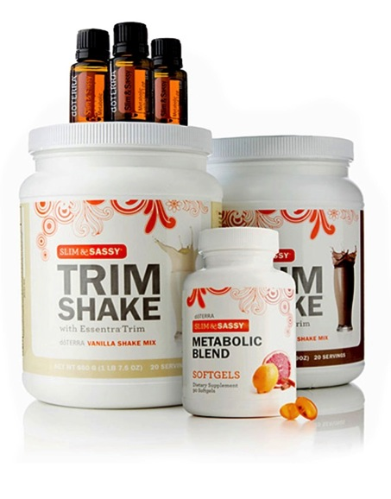
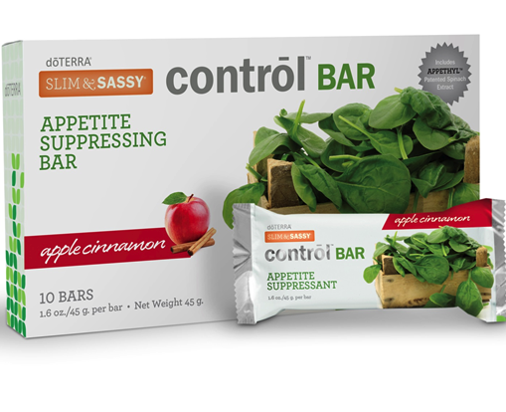
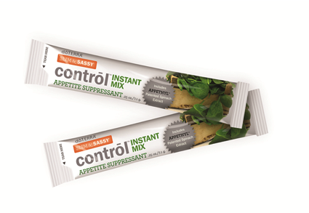
-
control
™
All-natural appetite-suppressing weight loss products*
*These statements have not been evaluated by the FDA. This product is not intended to diagnose, treat, cure, or prevent any disease
Notes:
We believe that our Appethyl spinach extract is by far the best researched and most effective weight management ingredient we’ve seen, and it’s nothing short of amazing! We have secured the exclusive rights to Appethyl in our business channel, and we’re excited to provide the full clinically tested amount in each serving of Slim & Sassy Control.
We recommend using Control as part of the doTERRA Slim & Sassy program, and we’re confident that Control will help you take control of the long-lasting lifestyle improvements that lead to successful weight loss.

